Slide 1
Predictive Analysis of Newspaper Subscribers Using Big Data
TEAM 3
Meghana Katta
Prof. Huajun Zhang
AIT-614: Big Data Essentials – Section 003
George Mason University
November 27th, 2023
MONDAY ● NOVEMBER 27 ● 2023
AIT-614 FINAL PROJECT PRESENTATION
TEAM 3

Slide 2

INTRODUCTION
In the digital era, newspapers are navigating changing reader habits, emphasizing the need to understand subscriber behavior for reader retention.
Our project stands out by leveraging big data to create a predictive model from a rich Newspaper Subscribers dataset.
Unlike conventional methods, we focus on factors influencing subscriber retention, offering unique insights for informed, data-driven decisions in the evolving media landscape.
MONDAY ● NOVEMBER 27 ● 2023
AIT-614 FINAL PROJECT PRESENTATION
TEAM 3

Slide 3
OBJECTIVES
DATA PREPROCESSING AND CLEANING
EXPLORATORY DATA ANALYSIS (EDA)
IMPLEMENTATION WITH PySPARK AND SPARK MLib
DEVELOP A PREDICTIVE MODEL
We aim to prepare the Newspaper Subscribers dataset for analysis by ensuring it is free from errors and inconsistencies. This is crucial for the accuracy of our predictive model.
We will perform EDA to uncover valuable insights into subscriber behavior. By visualizing and summarizing the data, we can identify patterns, trends, and potential areas of interest.
Our primary goal is to build a predictive model that can determine subscriber preferences and forecast subscriber churn. This model will be a cornerstone of our project.
We will leverage PySpark and Spark MLlib to implement the predictive model, ensuring it can handle large-scale data for scalability and efficiency.
MONDAY ● NOVEMBER 27 ● 2023
AIT-614 FINAL PROJECT PRESENTATION
TEAM 3

Slide 4

SUMMARIZED PROJECT TIMELINE
SEP 17
to
OCT 1
OCT 15
to
OCT 29
NOV 12
to
NOV 26
Data Preprocessing and Cleaning
Exploratory Data Analysis (EDA)
Predictive Model Development
PySpark and Spark MLlib Implementation
Model Evaluation and Fine-Tuning
OCT 1
to
OCT 15
OCT 29
to
NOV 12
MONDAY ● NOVEMBER 27 ● 2023
AIT-614 FINAL PROJECT PRESENTATION
TEAM 3

Slide 5
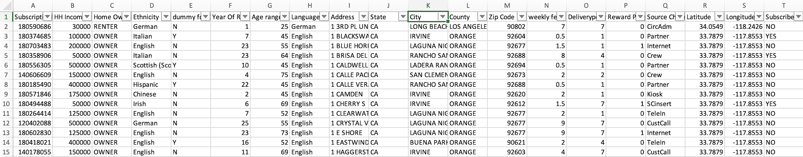
SELECTED DATASET
We have selected a dataset that contains over 15,000 records of newspaper subscribers. The dataset is rich in demographic information, including household income, home ownership, age range, and more.
Fig: Snippet of the selected dataset
MONDAY ● NOVEMBER 27 ● 2023
AIT-614 FINAL PROJECT PRESENTATION
TEAM 3

Slide 6
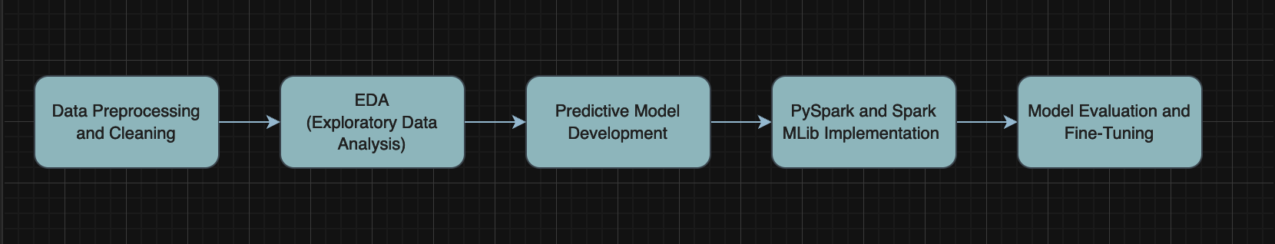
THE SYSTEM
Architecture:
Our project architecture unfolds in strategic steps. We begin by ensuring our data is intact through meticulous preprocessing. Next, we dive deep into the data's secrets through exploratory analysis. With these insights, we craft a powerful predictive model. Leveraging PySpark and Spark MLlib, we implement this model at scale. Rigorous evaluation and fine-tuning follow, ensuring our crystal ball of predictions is both accurate and reliable.
Fig: Proposed System Architecture
MONDAY ● NOVEMBER 27 ● 2023
AIT-614 FINAL PROJECT PRESENTATION
TEAM 3

Slide 7
Data Processing and Analytics Approaches:
THE SYSTEM
In our data processing journey, we ensure the reliability of insights through meticulous cleaning, guaranteeing our dataset is error-free. Leveraging advanced analytics approaches, we delve into subscriber behavior patterns using visualizations and summaries. This robust data processing and analytics combination allows us to uncover valuable insights and set the stage for our predictive model's development.
SW/HW Development Platforms:
For our project, we have used smart tech tools. Our data is managed with a NoSQL database called Databricks DBFS. The cool part is PySpark and Spark MLlib—these are superheroes helping us build and run our prediction model.
MONDAY ● NOVEMBER 27 ● 2023
AIT-614 FINAL PROJECT PRESENTATION
TEAM 3

Slide 8
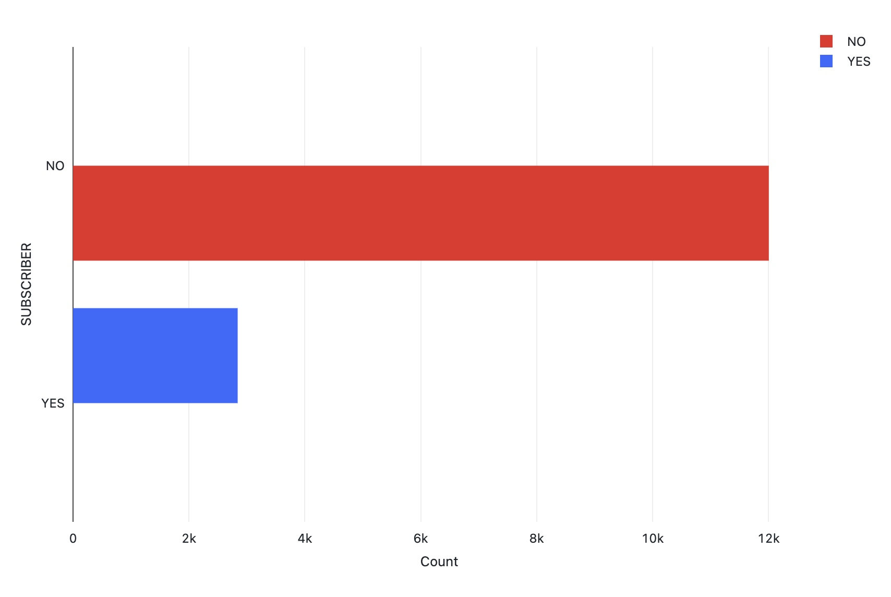
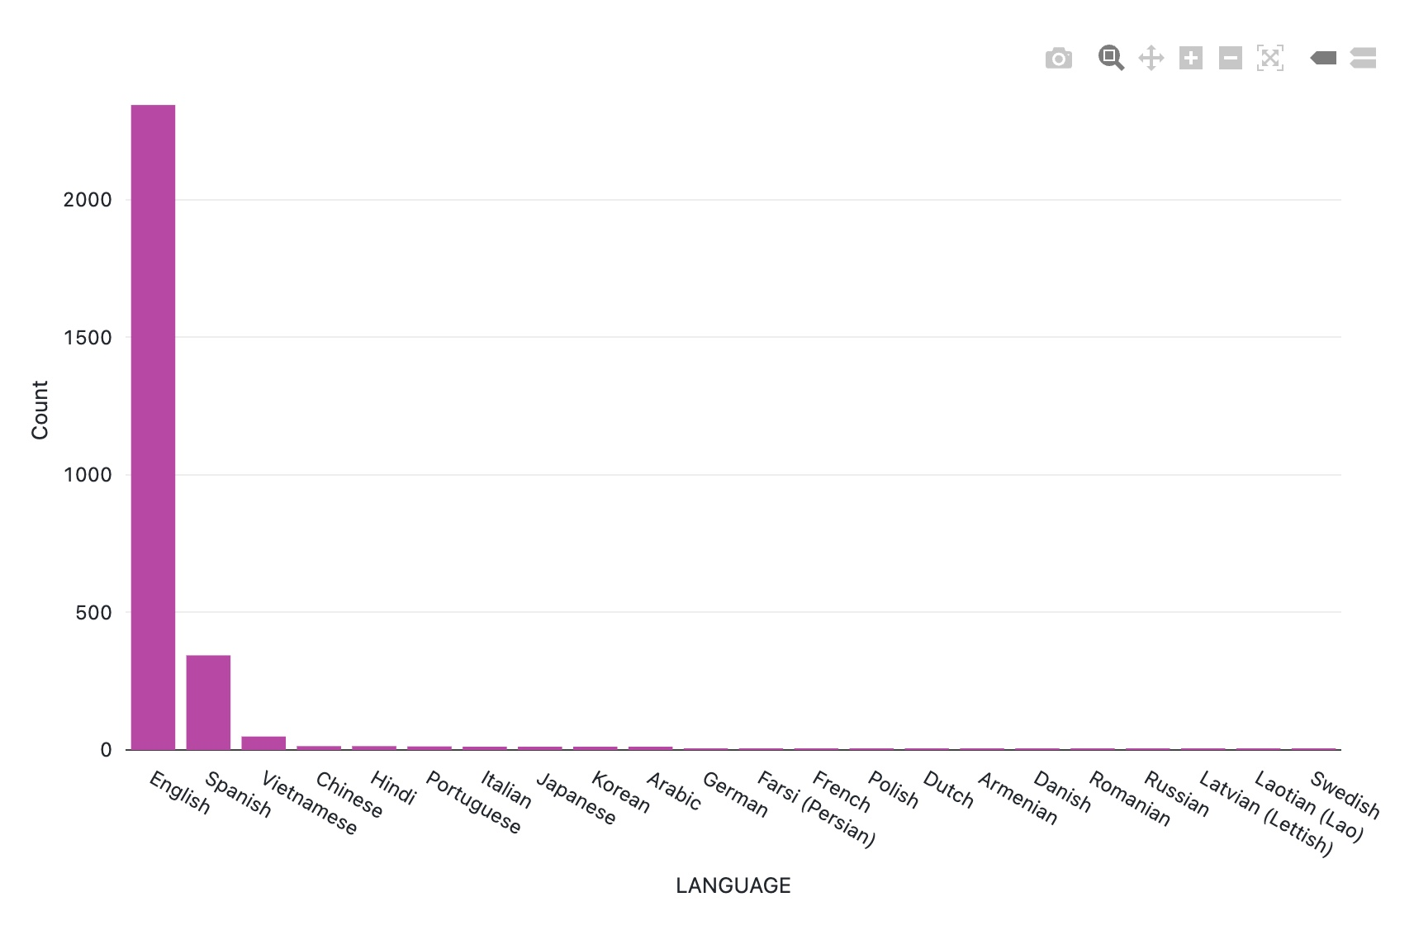
EXPERIMENTAL RESULTS AND ANALYSIS
1. What is the distribution of the number of subscribers and unsubscribers in the dataset?
2. What is the language distribution among the subscribers?
We have filtered the subscribers and grouped the dataset based on the languages column and plotted a bar graph from the counts. English newspapers were most used by the people
We have grouped the dataset based on the subscriber column and plotted a bar graph from the counts. The number of subscribers are 2481 and number of unsubscribers are 12007 in the given dataset

Slide 9
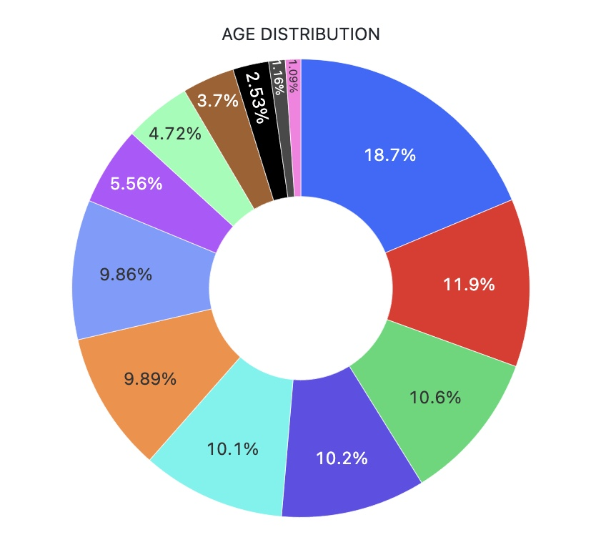
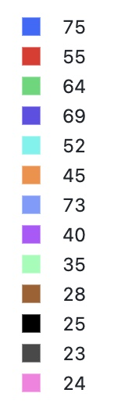
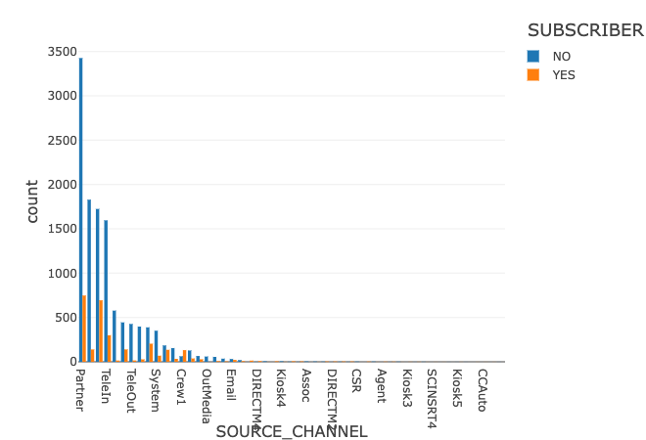
EXPERIMENTAL RESULTS AND ANALYSIS
3. Which age group are likely to be subscribers?
4. Which source channel made the most impact on who subscribed and unsubscribed?
We have grouped the dataset based on the age column and plotted a pie graph from the counts. The age group of 75 are likely to be subscribers.
We have grouped the dataset based on the subscriber and source channel to compare the count of each source channel. The partner source channel had the most number of subscribers and unsubscribers.

Slide 10
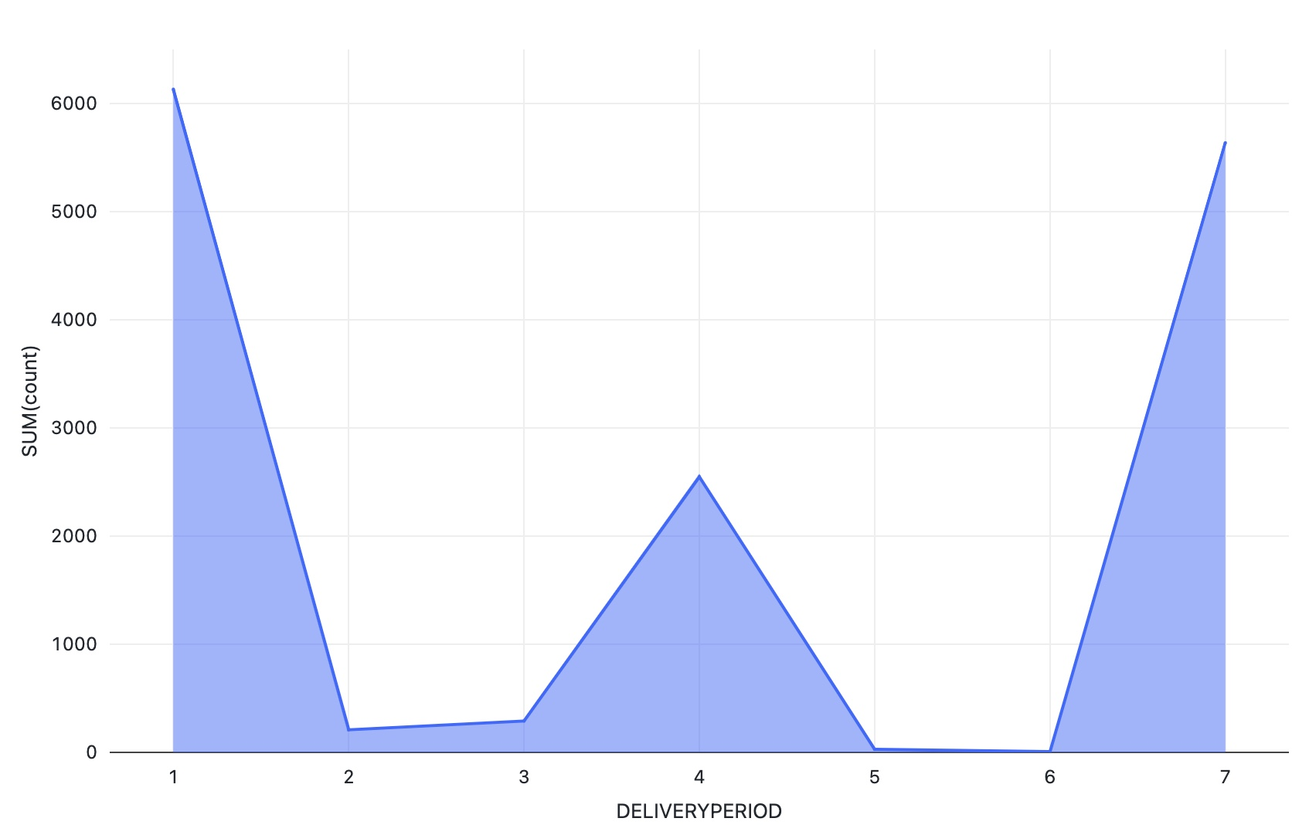
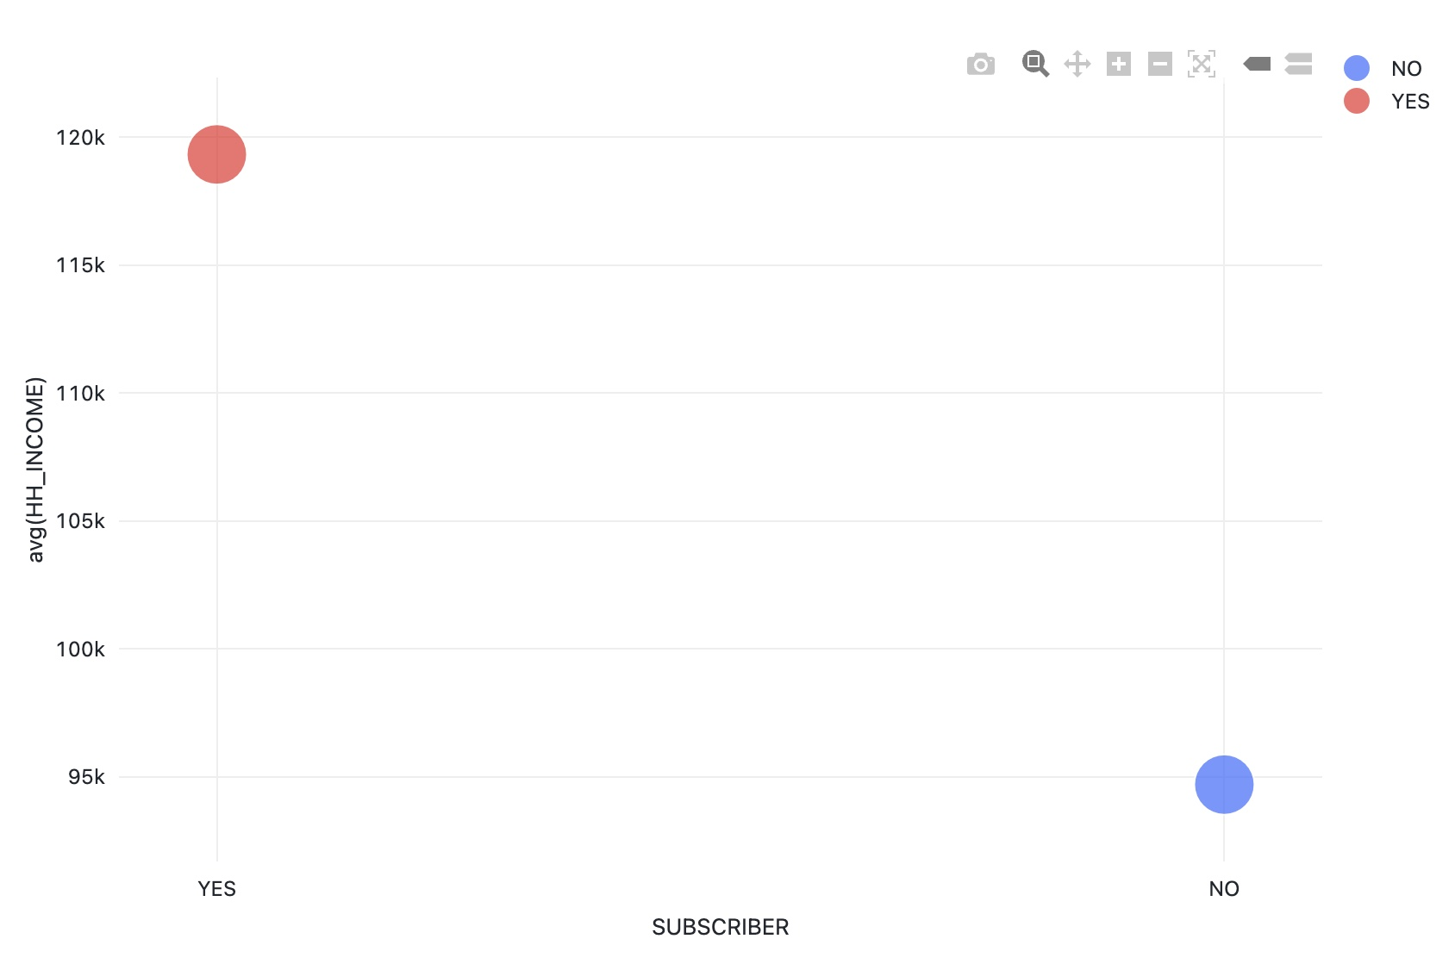
EXPERIMENTAL RESULTS AND ANALYSIS
5. Which delivery period is best to maintain the subscribers?
6. Is lower income a factor for unsubscription?
The data is grouped based on the delivery period and the count is plotted in area graph. The delivery in 1 day had more subscribers
The average income of unsubscribers was low when compared to subscribers. Low income is a factor for unsubscription. The bubble plot shows the income

Slide 11
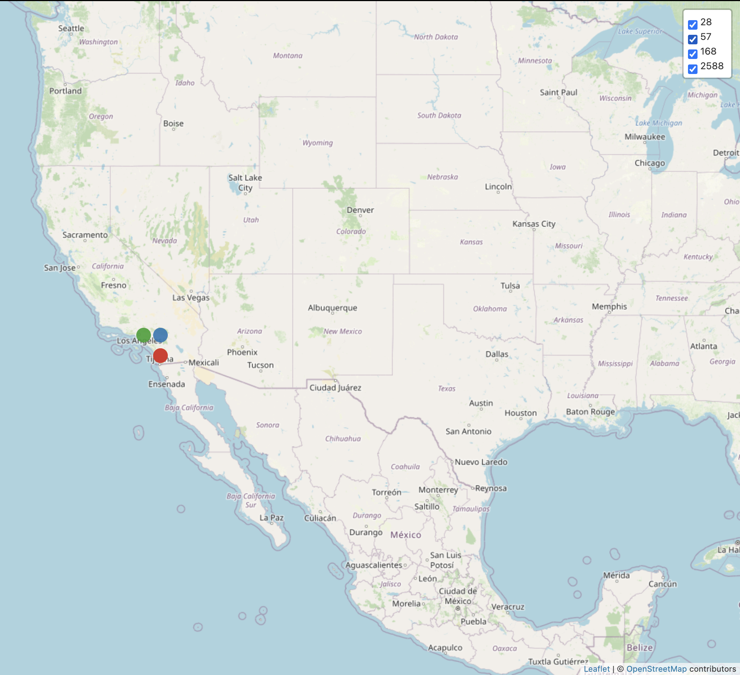
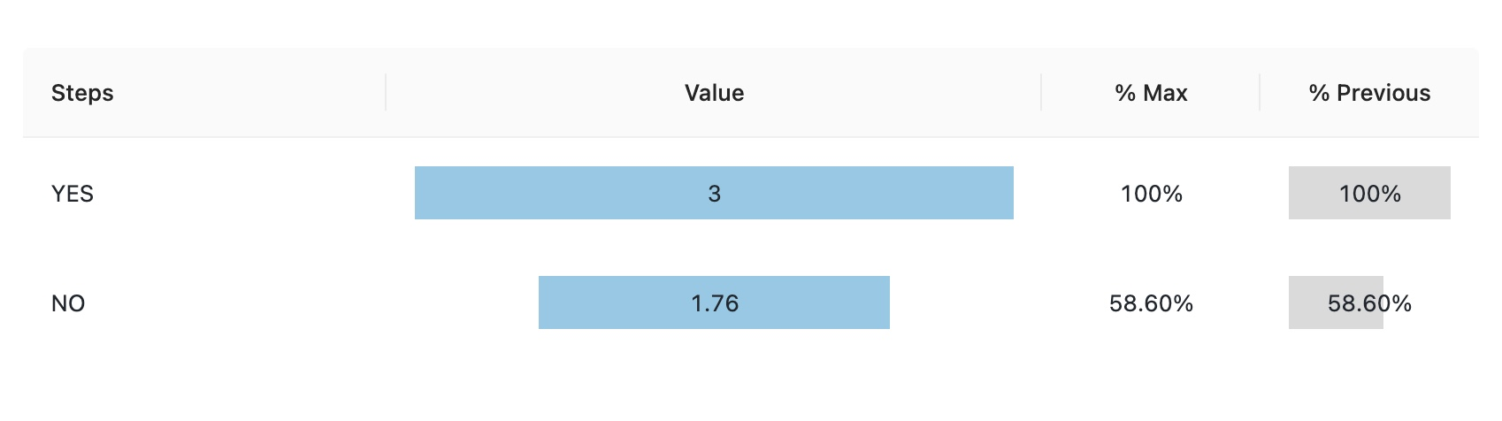
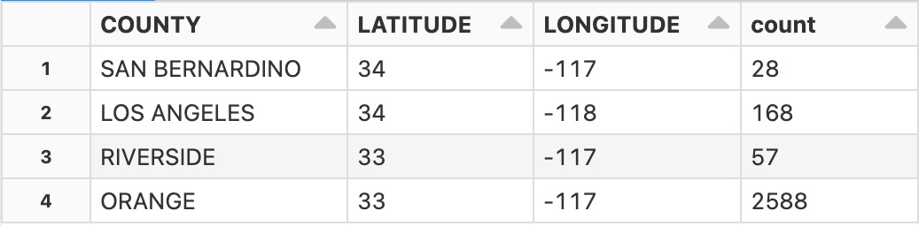
EXPERIMENTAL RESULTS AND ANALYSIS
7. Which county has the most number of subscriptions?
8. What is the average weekly fee? Is there any impact of the weekly fee on subscribers?
The average weekly fee is 3 dollars per week for the subscribers and for people who don’t have a subscription is 1.76 dollars which can be interpreted from the graph.
The top 3 counties with more subscriptions from the analysis are the Orange, Los Angeles, Riverside

Slide 12

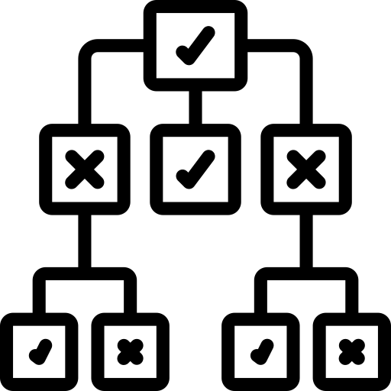
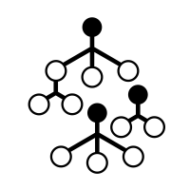
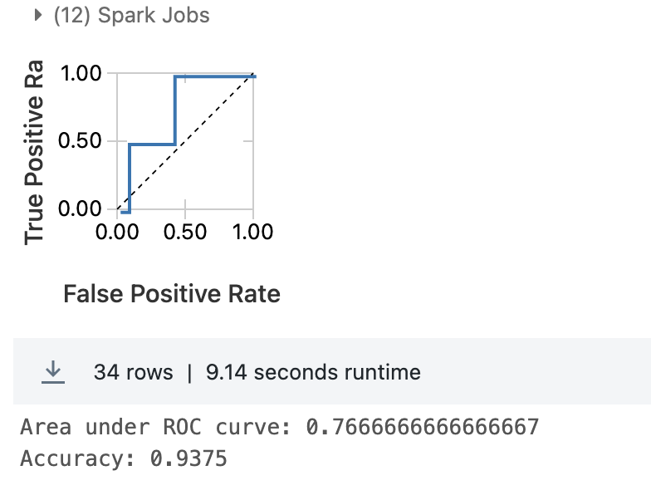

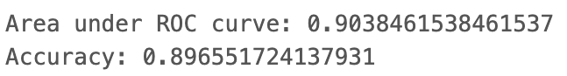
EXPERIMENTAL RESULTS AND ANALYSIS
Logistic Regression
Decision Tree
Random Forest
Logistic regression is used to build a predictive model for subscribers. Pipelines are used to train and fit the model and evaluation was done using accuracy and ROC
Decision trees were used to build a model for predicting subscribers. The evaluation was done using accuracy and ROC.
The results of accuracy and ROC are below:
Random forest is used to build a more complex model for predicting subscribers. The evaluation was done using the same metrics as decision trees. Multiple methods were used to compare their performance and identify the most effective approach for predicting subscribers in this dataset.
The results of accuracy and ROC are below:

Slide 13
CONCLUSION
Summary of Project Conclusions
Successfully achieved objectives: Data preprocessing, EDA, predictive modeling, and implementation with PySpark and Spark MLib.
Significant insights were gained into subscriber behavior and preferences.
The predictive model demonstrates effectiveness in forecasting potential churn.
Lessons Learned
Importance of thorough data preprocessing for model accuracy.
Significance of EDA in identifying actionable patterns.
Challenges and resolutions during PySpark and Spark MLlib implementation.
Future Work and Potential Enhancements
Explore advanced machine learning algorithms for more accurate predictions.
Incorporate real-time data for dynamic model adaptation.
Collaborate with industry experts for a more comprehensive understanding of subscriber behavior.

Slide 14
ACKNOWLEDGMENT
Recognition of Contributors:
Thankful for the guidance and support from Huajun Zhang, our professor.
Appreciation for the collaborative efforts of Team #3 members: Aakash Boenal, Kiranmai Reddy Varakantam, Meghana Katta, Rishitha Madipelli, and Shreya Gowrishetty.

Slide 15
REFERENCES
[1] geiler, l. (10, May 2022). NewspaperChurn . Retrieved from Open ML: https://api.openml.org/d/44226
[2] Belchior, L. M. (2022, November). Churn Prediction in Online Newspaper Subscriptions. Retrieved from Run Repositorio Universidade Nova: https://run.unl.pt/bitstream/10362/148914/4/TGI1079.pdf
[3] Peña, V. C., Malthouse, E. C., & Mersey, R. D. (2023). Churning off the news: An analysis of newspaper subscriber churn across digital devices. Newspaper Research Journal, 44(2), 190-205. https://doi.org/10.1177/07395329231167374
THANK YOU

